Slide 1
Software Security

Slide 2
Recap of Week 9
Communication between computers
Firewall
  network based vs host based
  open policy vs close policy
  IP filter vs Application gateway
IDS
  Signature-Based vs Anomaly-Based
  Accuracy
    Recall, Precision, Specificity

Slide 3
Overview
Content
  Vulnerabilities & countermeasures
    Command Injection
    Buffer overflow
  Malware & Malware Analysis
  Program Analysis for analysing vulnerabilities and malware
After this module, you should be able to
  understand secure programming and software vulnerabilities
  understand what is malware and types of malware
  explain security analysis techniques

Slide 4
Secure Programming and Vulnerabilities

Slide 5
Motivation Example
void main(int argc, char **argv) {
char buf[1024];
sprintf(buf,”cat %s”,argv[1]);
system (buf);
}
The program expects a file name as a command line argument
  cat dump the file content.
What can go wrong?
  Adding “;” after file name to supply more commands, e.g., “file;ls”
  User can set command line arguments to almost anything, e.g., by supplying the location of a program to start the program, “file;/path/to/malware”.
Programs may show undesirable behaviors when being fed with unexpected inputs.
For exam, No need to be able to write code. Just understand how it works!!!

Slide 6
Vulnerability
Definition: A flaw in a software, firmware, hardware, or service component resulting from a weakness that can be exploited.
Potential consequences:
  code injection: attacker manages to inserts his own code to the victim program and run it.
  control flow hijacking: attacker changes the flow of the program by changing the data in use without modifying the victim code or injecting his own code.
  data leakage
  execution correctness
  denial of service
  ...
The actual consequence depends on the program, the vulnerability and how it is triggered.
An attack may involve multiple vulnerabilities.
Notes:
Redirect control to run something unexpected – DOS attack
Leak the data and crash the service. Changing flow of events.

Slide 7
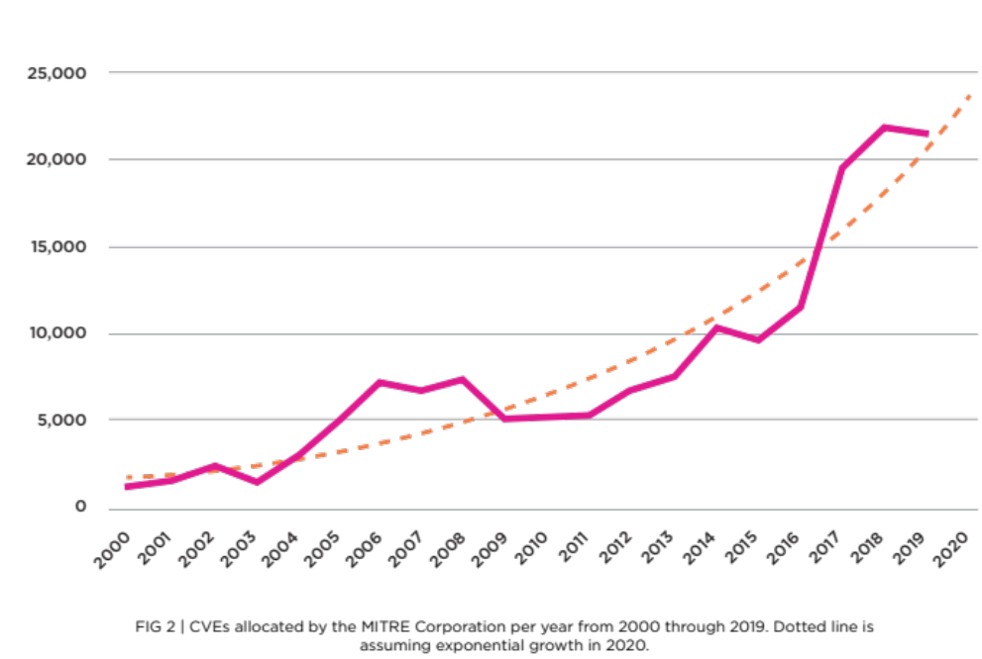
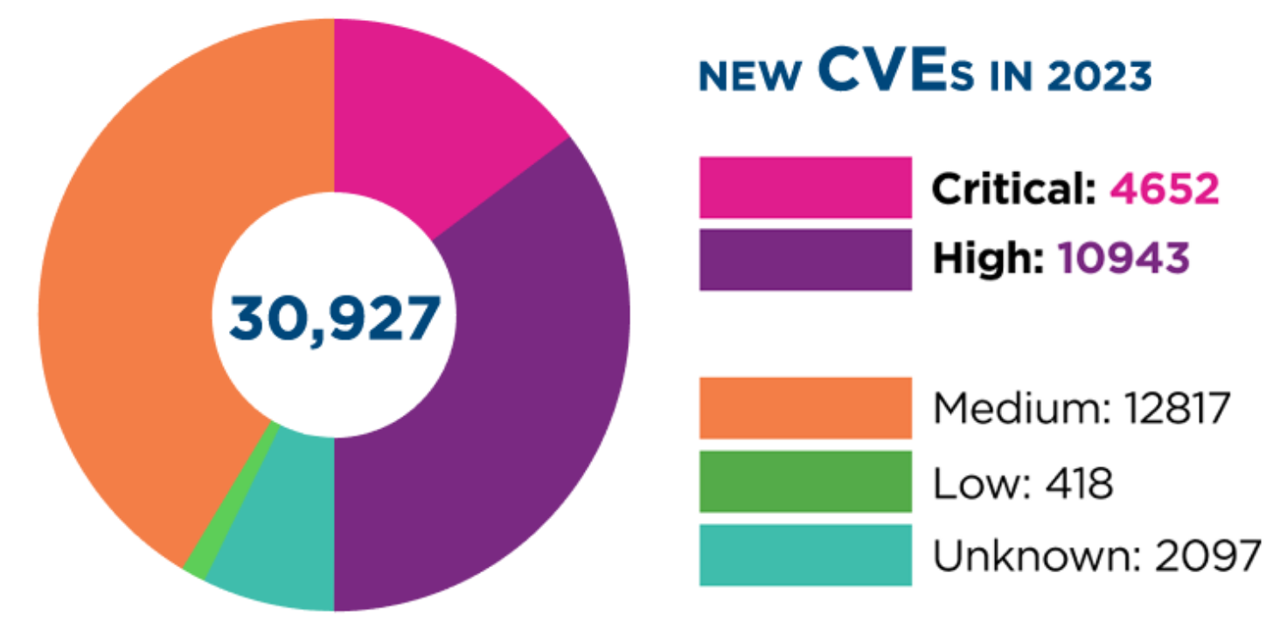
Trends of Vulnerabilities
Common Vulnerabilities and Exposures : https://www.cve.org/ The database of publicly disclosed vulnerabilities.
Top 25 software weakness
https://cwe.mitre.org/top25/archive/2024/2024_cwe_top25.html
Vulnerability and Threat Trends Report 2020 by Skybox (Mid-year update)
CVE reported in 2023

Slide 8
Handling Program Input
Input refers to any source of data from outside the program and is not known when the code is written.
  data read through keyboard, mouse, file, network packets
  command line arguments, environment variables
  data supplied by other programs or configuration value by OS.
Interpretation of input: interpretation and meaning.
Notes:
Malware – evil software.
Normal programs – usage of Benign software and use malicious data to exploit (itself is not evil. But cos of vulnerability thus cause leaking, DOS, unintended function, control of flow)

Slide 9
Common Input Validation Vulnerabilities
Malicious inputs can become code, or change the logic to do things that are not intended.
Common input validation vulnerabilities include:
  OS command injection, directory traversal
  Memory corruption vulnerabilities in C/C++
    e.g., Out-of-bound read/write
  SQL Injection, XSS (to be discussed in Web Security)
Notes:
Directory traversal not going through, memory corruption.
Directory traversal is like cd ../ etc and entering into sudo without the proper auth. Validation is not done.
You can blacklist some characters. Like open and close policy. Whitelisting is safer (Close policy)

Slide 10
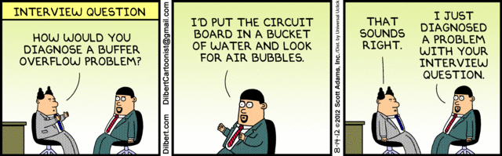
Buffer Overflow
Dilbert: 14-Aug-2012
Memory corruption vulnerabilities

Slide 11
NIST’s definition of BO
Buffer overflow: A condition at an interface under which more input can be placed into a buffer or data holding area than the capacity allocated, overwriting other information. Attackers exploit such a condition to crash a system or to insert specially crafted code that allows them to gain control of the system

Slide 12


Typical Buffer Overflow Attack Scenario
Users enter data into a Web form
Web form is sent to server
Server writes data to buffer, without checking length of input data
Data overflows from buffer
Sometimes, overflow can enable an attack
13214sgtrekfj34dvk4
13214sgtrekfj34dvk4
buffer
00000
malicious Web client
13214s
gtrekfj
Web server
Web based attack could be carried out by anyone with an Internet connection

Slide 13
Memory Layout of Programs
Address
Contents
All code and data are accessed by using their addresses.
For example:
  the entry address of function1 is at address 10108.
  buffer1 is between address 80100 and 80107. It has 8 bytes.
High
buffer3
80138
buffer2
80108
buffer1
80100
function1
10108
function2
Low
10001
simplified memory view

Slide 14
Example of Buffer Overflow
strcpy(dst,src) function
  dst and src are variables pointing to two memory buffers.
  It copies the character strings in src buffer to dst buffer.
  A character string terminates at byte '0x0'.
High Address
Low Address
'0' | '1' | '2' | '3' | '4' | '5' | '6' | 'a' | 0x0
dst
dst+1
dst+2
dst+3
dst+4
dst+5
dst+6
dst+7
dst+8
suppose dst buffer is 7 bytes.
strcpy(dst,"0123456a") leads to buffer overflow.
Notes:
Dst. Is basically the buffer starting point.
Overflow upwards.
0x0 is the num char, denote end of string.

Slide 15
Consequence of Buffer overflow
Overflow in buffer1 modifies data in buffer2. The direction of overflow is towards the higher addresses.
The consequence depends on how the modified data is used by the program.
Examples:
  Buffer2 stores the authentication outcome which determines how the program run after authentication.
  Buffer2 stores data that will be directly used for the destination of a control transfer instruction such as "goto the address stored at 80108" – ROP without gadgets, run to next line and then it will run the method.
Address
Contents
buffer3
80138
buffer2
80108
buffer1
80100
bypass authentication
function1
10108
system crash
OR
run unintended code
function2
10001
strcpy(buffer1,"01234567abcd")
Notes:
Buffer2 can be used to bypass auth already is buffer2 is result from auth.
Buffer2 can be used to distrupt the flow if it is controls.
It’s a stack, run from top to bottom.

Slide 16
An example of Buffer Overflow
#include <stdio.h>
#include <string.h>
void X(const char* input)
{
char buf[10];
//Not passing any arguments is a trick to view the stack.
printf("My stack looks like:\n%p\n%p\n%p\n%p\n%p\n%p \n%p\n%p\n%p\n%p\n%p\n%p\n%p\n\n");
//Pass the user input straight to secure code public enemy #1.
strcpy(buf, input);
printf("%s\n", buf);
printf("Now the stack looks like: \n%p\n%p\n%p\n%p\n%p\n%p\n%p\n%p\n%p\n%p\n%p\n%p\n%p\n\n");}
FYI Only

Slide 17
Before strcpy(buf, input)
After strcpy(buf, input)
My stack looks like:
00000018
00000001
0023FF14
0000000C
0023FFE0
77C35C94
77C146F0
FFFFFFFF
0023FF60
00401401
00032593
00401328
Hello
Now the stack looks like:
00000018
00000001
0023FF14
0000000C
6C6C6548
77C3006F
77C146F0
FFFFFFFF
0023FF60
00401401
00032593
00401328
Low Address
FYI Only
“Hello” was copied in
0x6C-’l’, 0x65-’e’, 0x48-’H’, 0x6F-’o’
0x0040141 is the return address of function X
High Address

Slide 18
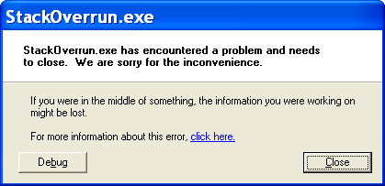
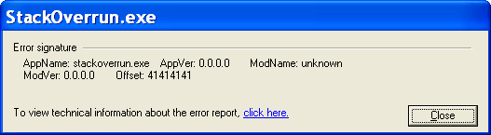
AAAAAAAAAAAAAAAAAAAAAAAAAAAAAAAAA
Now the stack looks like:
00000018
00000001
0023FF14
0000000C
41414141
41414141
41414141
41414141
41414141
41414141
41414141
41414141
My stack looks like:
00000018
00000001
0023FF14
0000000C
0023FFE0
77C35C94
77C146F0
FFFFFFFF
0023FF60
00401401
00032593
00401328
0x41 ‘A’
FYI Only
CPU attempts to fetch instruction from address
0x41414141 ☹

Slide 19
Countermeasures for Memory Corruption Vulnerabilities

Slide 20
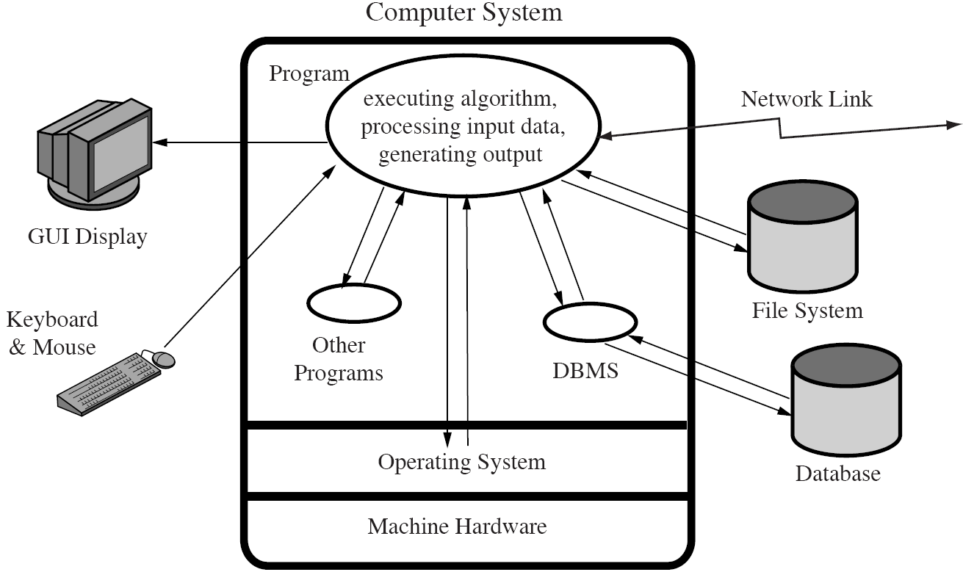
Secure Programming
A main difference between secure programming and normal practices is that Nothing is assumed!
Mindset Change
how to accomplish the task
know the consequence of failures and attack techniques
Notes:
Finisih it or how to make it good.

Slide 21


Good programming practices
Use safe APIs instead of unsafe APIs.
  strcpy(dest,src) copy the src character string to dest.
  strncpy(dest,src,num) copy the first num characters in src string to dest.
  Which one of the above is riskier?
Apply proper input validation
  Must identify the maximum expected size of input
  Check for things that are not allowed (blacklist)
    sanitize/escape blacklisted characters (e.g., semi-colon “;”, “../”)
    The blacklist may not be exhaustive
  Check for things that are allowed (whitelist)
    may cause false positive
Notes:
This is why input validation is important. Length is always important.

Slide 22
System Supports
Immutable code and inexecutable data in the memory
  The OS has an ACL-like approach to specify whether bytes in a memory region can be read, written or executed. – each memory page has a flag in virtual memory address space.
  An effective way to prevent an adversary from inserting its own code.
  The OS has something like ACL to see which memory buffer can be used.
Address randomization when a program is launched. – don’t know which particular location to direct to. Can still override some parts but harder for attacker to insert certain information at specific buffer
  It will be harder for the attacker to predict the consequence of overflow or choose the target to attack.
  Windows, Linux and other UNIX variants by default has enable coarse-grained address space layout randomization (ASLR).
Control flow integrity enforcement.
  During execution, the program checks whether a control transfer destination in use violates predefined policies.
  supported by modern compilers, e.g., GCC, LLVM, or Microsoft Visual Studio
  Can add some additional checking to see if the dest they are going is valid/legal or not. Will the trf of control be legitimate or not.
  CFI and CFG difference – CFG is made first, then CFI is used to track that CFG to see if the current flow follows the CFG.
buffer 2
89106
81002
buffer 3
buffer 1
60100
10108
function1
function2
10001
dest= 10156
Y
N
is dest legal
goto dest
abort
created by compiler for CFI

Slide 23
Language Support (Memory-safe languages)
Some programming languages have built-in defence against memory errors.
  Java
  Python
  C#
  Rust
They are typically interpretation based execution.
  Require an interpreter program to interpret “instructions” of them into machine instructions before execution.
Safer but slower!
Java code
C code
compiler
Intermediary code
compiler
Interpreter
Machine instructions
Machine instructions
Notes:
C is not memory safe.
Java interprets the runtime based on the intermediary code.

Slide 24
Malware
Notes:
Created for malicious purposes.

Slide 25









Malware Family
logic bomb
time bomb
virus
rabbit
Trojan horse
worm
trapdoor
bot
Notes:
Differentiate malware to malware.

Slide 26
Malware Categorization
Based on independence
  Parasitic: fragments of programs that cannot exist independently of some actual programs. – survive in programs.
  Self-contained: independent programs scheduled and run by OS – can just live on computer
Based on replication
  Replicating: produce one or more copies of itself
  Non-replicating: do not replicate
 | parasitic – needs host to survive | self-contained – live on its own
Replicating
Non-replicating

Slide 27
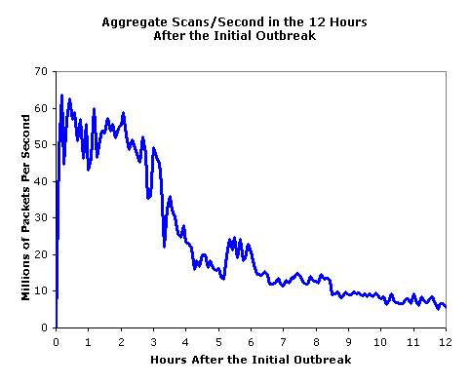
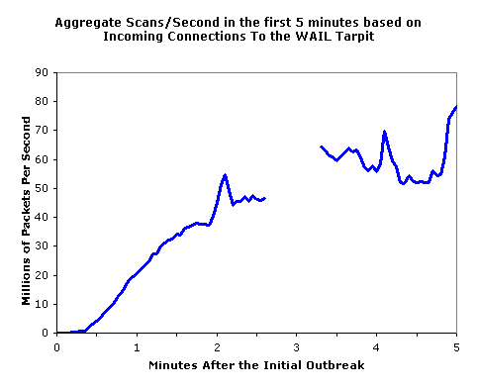
Worm
Worm ⎯ a program that can replicate itself and send copies from computer to computer across net work connections.
First worm by Xerox lab, non-malicious, search for idle system to run a computationally heavy task
SQL Slammer infected 250,000 systems within 10 minutes!
Notes:
Replicate and can send around in OS. Can survive on its own and can just replicate.
Replicate, find random Ip address, and send. If address exists, it will be infected. All computers in network will be screwed.

Slide 28
Botnet
Bot: (a.k.a. zombie) is a program that secretly takes over an Internet-attached computer and uses that computer to launch attacks, under a remote control.
Remote Control Facility (communication channel for the boss bot to communicate with the minion bots.):
  by an IRC channel.
  covert communication channels via protocols e.g., HTTP.
Botnet construction:
  need a vulnerability in a large number of systems.
Widely used in DDoS attacks
Notes:
Network of bot : zombine machines
Use network of machines to launch attacks (computers affected by the bots)
Group communication channel can be used to infect all.
You need to know vulnerability in multiple systems/machines.

Slide 29
Ransomware
Ransomware is malware that denies legitimate accesses to resources such as files, databases, even the whole computer and demands payment to restore accesses.
  it is the primary security concern for today’s small and median enterprises.
Well-known ransomware
  Petya, WannaCry, SamSam, CryptoLocker etc.
Well-known attacks
  Ukraine (2017), Colonial pipeline (2021), UK National Health Service (2024), UnitedHealth (2024)
Most ransomware applied data encryption to prevent user accesses.
Notes:
Pay money to unlock computer.
Used by attacker for bad purpose.
Uses AES encryption to encrypt the victim device.
Mcm like kidnapping your machine.

Slide 30
Program Analysis
To analyze software vulnerabilities and malware

Slide 31
Program Analysis
Program Analysis analyses and extracts program signatures and behaviours
Two types of program analysis in general.
  Static Analysis: do not execute program
  Dynamic Analysis: execute program
It can be used to extract malware signatures and understand their behaviours
Likewise, it can be used to analyse a given program to detect vulnerabilities

Slide 32
Static Analysis
Does not need to execute the software;
Statically analyse its source code or binary code to understand its behavior, typically by extracting graphs (CFG, call graph, etc.)
  e.g. APIs used to access sensitive data
  e.g. calling a network API immediately after accessing sensitive data is an indication of data leakage.
Advantage: rich semantics, low overhead, easy to implement, risk-free – no risk and ez.
Limitation: easy to evade (obfuscation); false alarms – undetected, false alarms (static analysis might alarm it because something seen dangerous but actually is not)
{
read_contact_file(contact, buffer)
network_send(buffer, destination)
....
}
suspicious code leaking contact info
Notes:
This is like a compiler. You can think of it like a compiler where it checks everything. But is to see what your code does, DOES NOT RUN.

Slide 33
Control-Flow Graph (CFG)
A way to represent the possible flow of control inside a function.
Nodes: called basic blocks. Each block consists of straight-line code without control transfer. (By default, CPU increments the current address to fetch the next instruction to execution, unless the current instruction in execution asks the CPU to go somewhere else, which is called a control transfer.)
Edges: An edge A → B means that control could flow from A to B.
There is one unique entry node and one unique exit node.

Slide 34
Control-Flow Graph (CFG)
ENTRY
int foo(int x) {
int y;
int arr[10];
x = x+1;
if (x<0)
y= -x;
else
arr[x] = 10;
}
B0:
B1:
x= x+1;
if (x<0)
True
B3:
False
B2:
y = -x;
arr[x] =10;
B4:
EXIT

Slide 35
Dynamic Analysis
func1{
read_contact_file(contact, buffer)
.. }
func2{
....
network_send(data, destination)
...}
funct3{
....
func1(..)
....
func4(...)
}
func4{
func2(...)
}
Monitor and control malware execution to collect the malware’s runtime behavior such as API calls, data flow, network traffic, etc.
Advantage: can obtain real data flows and control flows
Limitation: difficult to extract semantic information, high overhead to securely monitor malware execution (since malware may attack the monitor)
  Malware may also be checking whether they are being monitored…
read sensitive data
network send
Dynamic analysis is often used in tandem with static analysis in practice

Slide 36
Takeaway
Many software vulnerabilities arise from improper handling of inputs
  Inputs can be from users, environment variables, configuration files, network packets, etc.
Command injection and buffer overflow vulnerabilities are quite common
Operating system and programming languages have built-in support to prevent buffer overflows.
Malware can be categorized based on Independence and Replication
Vulnerabilities and Malware can be analyzed using static analysis and dynamic analysis.

